Slide 1
2MAE501: Architecture and Programming project
Factory of the Future

Slide 2
Table of Contents
General Overview
Requirements
Use-Case Diagram
Main Block Diagram
Internal Block Diagram
Interfaces
Network
Dashboard
Sensors
Machine Learning
All code available at github.com/guipenedo/factory-of-the-future/
Factory of the Future
/
07-12-2021
/

Slide 3
General Overview

Slide 4
Requirements
ID | Requirements | Subsystem
1 | Sensors and actuators shall be driven remotely. | Network Infrastructure
2 | Alarms shall be triggered in case of threshold violation and last for 60 seconds.
3 | Alarms shall be broadcasted over the network.
4 | Factories shall broadcast sensor data each 5 seconds.
5 | Factories shall implement at least a temperature/pressure/humidity sensor. | Factory
6 | Factories shall be capable of giving their list of available sensors/actuators.
7 | Factories shall implement at least an LED and a relay.
8 | Dashboard shall store received data. | Dashboard
9 | Dashboard shall display sensors data.
10 | Threshold on the measurement shall be adjusted.
11 | Dashboard shall display current factories status (actuators, sensors, alarm).
12 | Machine learning usage shall provide forecastings about factories sensors values. | Machine Learning
Factory of the Future
/
07-12-2021
/
Notes:
The requirements that our project fulfill are the following. Colors indicate the subsystem they are related to. Yellow is for the network infrastructure requirements, etc.

Slide 5
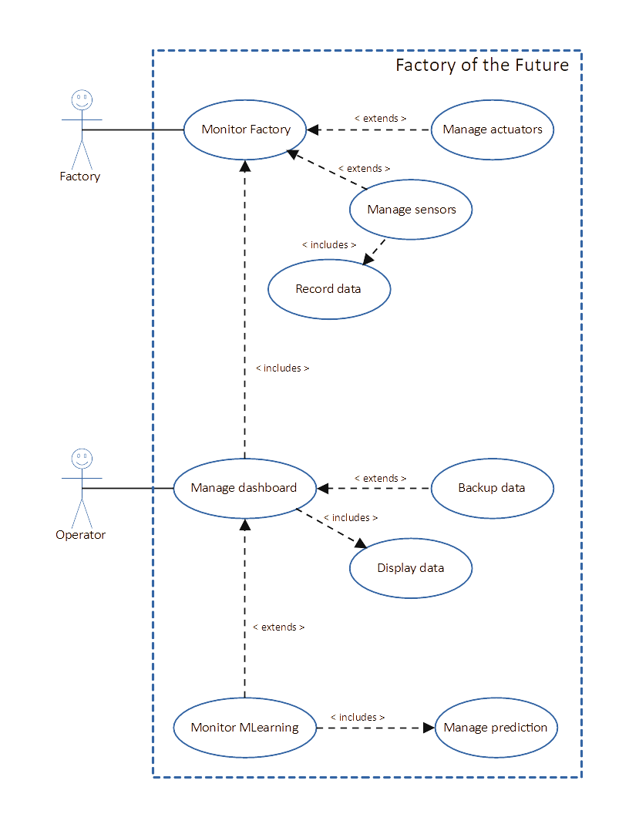
Use-Case Diagram
Use case diagram of the factory of the future
Factory of the Future
/
07-12-2021
/
Notes:
As we can see, the whole system is built around the end user; i.e. the operator. Hence all the internal transactions are merging in the dashboard.

Slide 6
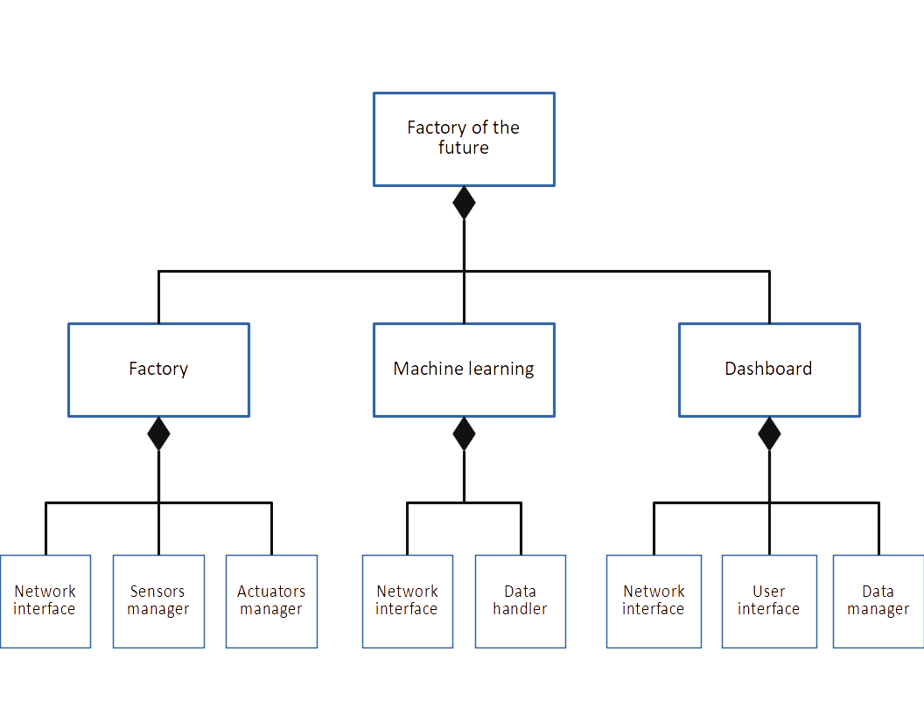
Block Diagram
Block diagram of a factory of the future
Factory of the Future
/
07-12-2021
/
Notes:
As a result, the factories of the future will require to embed multiple subsystems. And in each of them a network interface is necessary

Slide 7
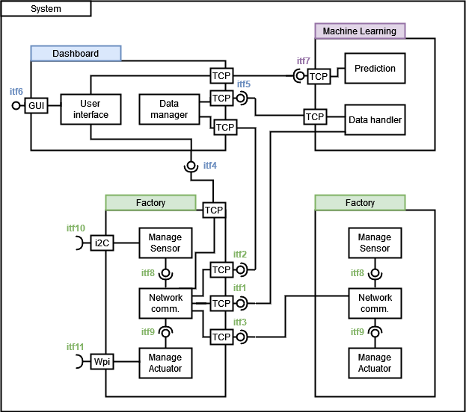
Internal Block Diagram
Internal block diagram of the project
Factory of the Future
/
07-12-2021
/

Slide 8
Interfaces list
ID | Provided to | Purpose | Subsystem
N/A | Any | send close comm. command from a server to all its clients | All
itf1 | ML | send sensors value history | Factories interfaces
itf2 | Dashboard | send sensors/status datas
itf3 | Factory | send sensors data
itf4 | Factory | new host init; send commands (alarm, led, relay); get sensor and actuators list | Dashboard interfaces
itf5 | ML | send commands (initialisation, ask for prediction)
itf6 | Operator | G.U.I. interactions
itf7 | Dashboard | send prediction for a specific factory | Machine Learning interfaces
itf8 | Sensor man. | send request for sensor data | Network communications
itf9 | Actuator man. | send order to drive the GPIO
Factory of the Future
/
07-12-2021
/
Notes:
They correspond to all the services server/client involved in the system

Slide 9
Network
Guilherme, Naël & Yannick

Slide 10
Network - Main Principles
The network provides a general and modular interface used by every actor
-> The factory of the future can be easily scaled-up
Every actors is connected by a client/server bridge
The dashboard is the “connection enabler”
Packets are strings formatted like so: “command id” + “args”
Args size is variable
Spaces are used as separators between each argument
Communication is always synchronous to ensure a deterministic behaviour
Only asynchronous communication for alarm trigger
Factory of the Future
/
07-12-2021
/

Slide 11
Network - TCP Server
Listens on all interfaces (INADDR_ANY)
New thread for each incoming connection
Serve client thread:
Infinite loop
Wait for msg from client (read)
Call command_handler function
Send back result of command_handler function
command_handler function:
void (int commandId, char * args, char * response, int connfd, char * client_ip)
Unique command id
Arguments for this command call
Buffer to write response on
Socket id
IP of client that sent command
Factory of the Future
/
07-12-2021
/

Slide 12
Network - TCP Client
One thread for each server connection
Server connection thread:
Infinite loop
Wait for command to send (pthread_cond_t)
Send CommandId and Args to Server
Wait for the response
Signal response received and save it
Sending a command:
Lock mutex
Save command data to structure
Signal that there is a command
Wait for response signal (blocking call)
Unlock mutex
Connection data stored in linkedlist.
Factory of the Future
/
07-12-2021
/

Slide 13
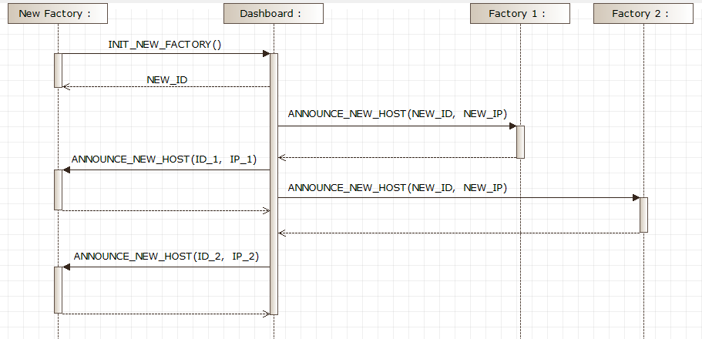
Network - Factory Initialization Sequence
Factory of the Future
/
07-12-2021
/

Slide 14
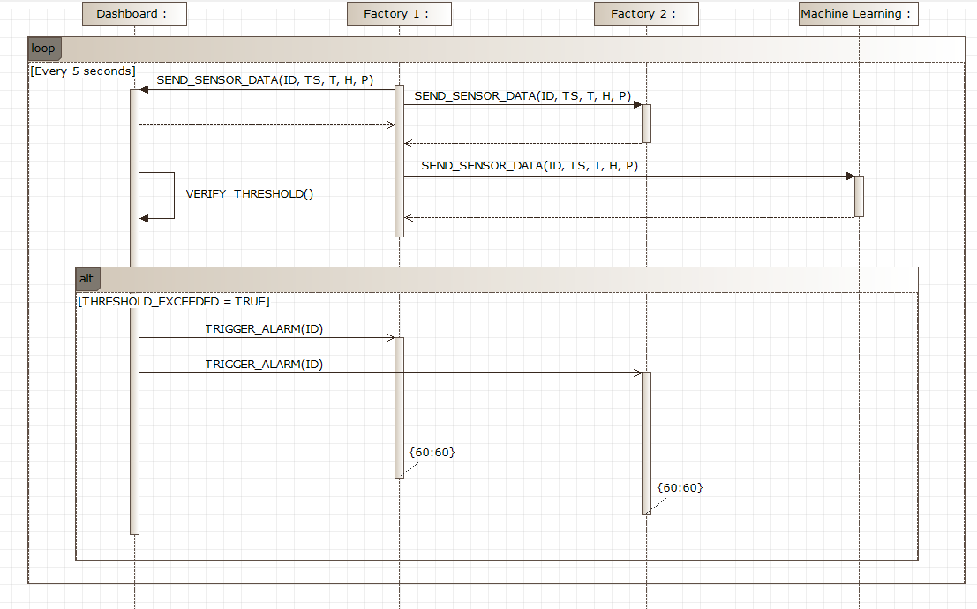
Network - Sensor Data Communication Sequence
Factory of the Future
/
07-12-2021
/

Slide 15
Dashboard
Alberto, Gonzalo, Joan & Nicola

Slide 16
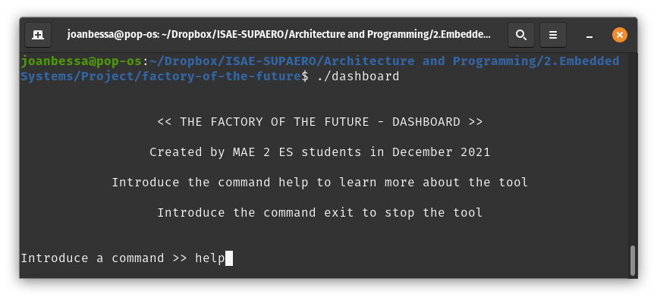
Dashboard - Main Principles
Act as a Central Control Unit for the distributed factory
Provide the user with a Command Line Interface
Display information and data from the factories
Factory of the Future
/
07-12-2021
/
Notes:
Alberto - The dashboard is basically the central control unit of the IoT system and its main feature is a command line interface that allow us to interact with the factories. This interface allow ask retest data or send commands to the different parts of the distributed factory.

Slide 17
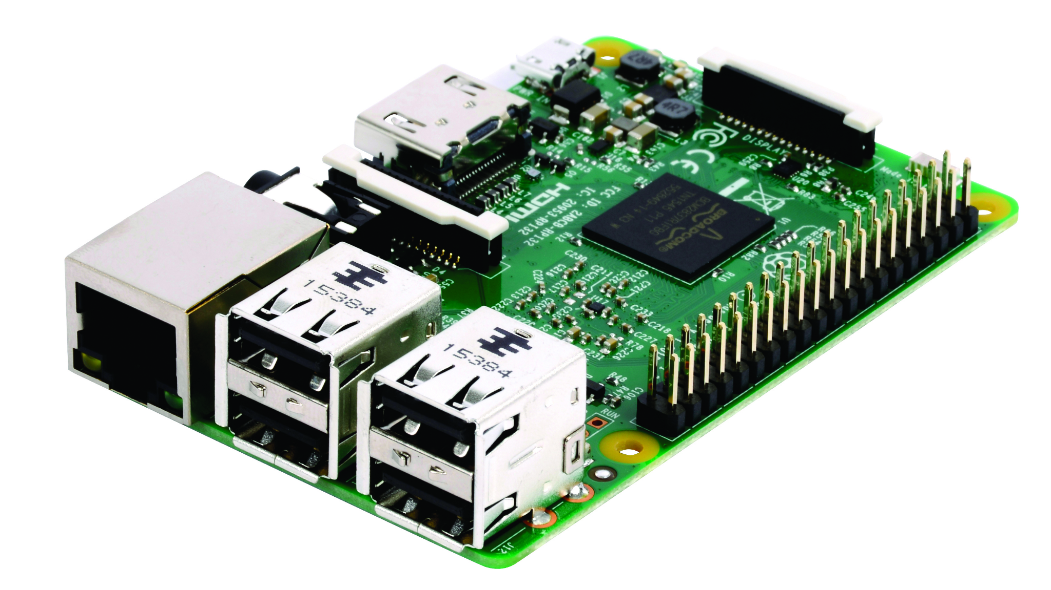
Dashboard - Main Principles
What does the main function do?
Assigns an ID to the recently connected factories.
Accepts TCP connections.
Runs the dashboard GUI.
Closes connections.
Factory of the Future
/
07-12-2021
/
Notes:
Alberto - Apart from that, the dashboard also accepts TCP connections giving an ID to each new factory and closes the conexions when the user introduces the command exit.

Slide 18
Dashboard - commands
All available commands:
show
plot
sendcom
settrheshold
downloadhistory
listperipherals
listalarms
predict
and the most important one: - help
Command functions include:
Detection of flags
Automatic error messages
Factory of the Future
/
07-12-2021
/
Notes:
Nicola

Slide 19
Dashboard - database
The next measures overwrite the latest ones when the database is full.
Time | Temperature | Humidity | Pressure
HH:MM:SS | ºC | % | Pa
HH:MM:SS | ºC | % | Pa
HH:MM:SS | ºC | % | Pa
HH:MM:SS | ºC | % | Pa
1
2
3
4
2000
HH:MM:SS | ºC | % | Pa
Factory of the Future
/
07-12-2021
/
Notes:
Nicola

Slide 20
Dashboard - factory_comm
Manages communication between Dashboard, Factories and Machine Learning
trigger_alarm
Instructs all factories to activate their alarm
sendcommand
Send command to a factory sensor
listPeripherals
For a given factory, lists the available sensors/actuators
getPrediction
Demands a prediction from the ML module and prints it
Factory of the Future
/
07-12-2021
/
Notes:
Gonzalo -> send command: id, led/relay, ON/OFF
listPeripherals: also their state

Slide 21
Dashboard - factory_data
Manages communication between Dashboard, Factories and Machine Learning
downloadhistory
Download factory data into a text file
showhistory
Shows the downloaded text file in the interface
Factory of the Future
/
07-12-2021
/
Notes:
Gonzalo -> showhistory: select file by id and then set the number of lines to be displayed

Slide 22
Dashboard - listing
Lists the factories as well as their alarm state.
listFactories
Shows the current factories connected to the network.
listAlarms
For all the current connected factories, display the current state of their alarms (ON, OFF).
Factory of the Future
/
07-12-2021
/
Notes:
Joan -> Both use linked lists to display all the factories separately

Slide 23
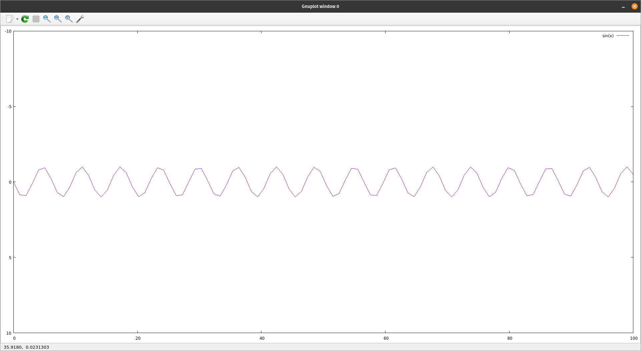
Dashboard - plot
Provides plotted information of the sensors
plot_sensors
Plots the latest information of all the sensors within a factory using gnu_plot
Factory of the Future
/
07-12-2021
/
Notes:
Joan -> Uses previously presented database of 2000 time units. Uses gnuplot program in order to provide a plot for all the sensors in a single factory.

Slide 24
Sensors & Actuators
Fernando, Neel, Tatiana & Wendi

Slide 25

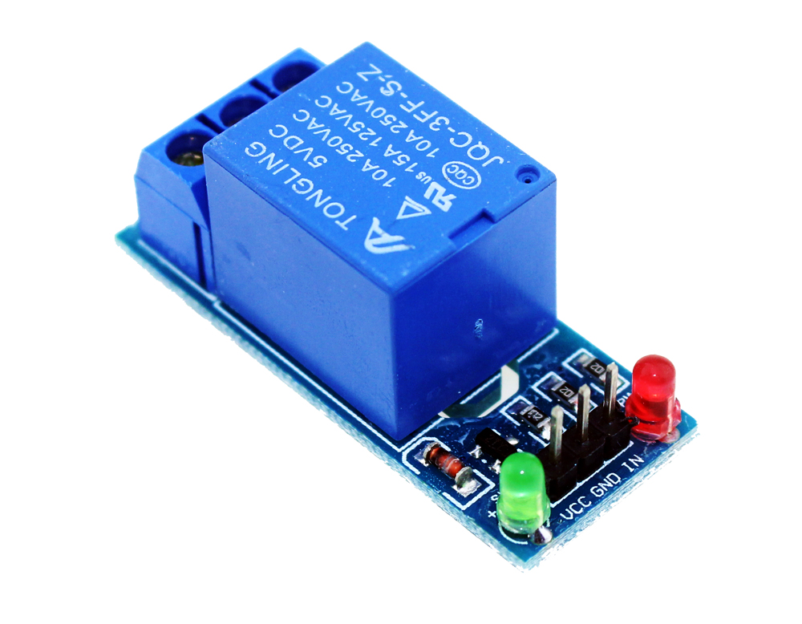
Description of the System
Each factory is equipped with its own set of sensors and actuators.
Every factory has a BME280 sensor which measures three separate parameters. The data taken from the sensor is transmitted periodically by each factory.
Each factory is equipped with three types of actuators -
LED
Relay
Buzzer
LED
RELAY
Factory of the Future
/
07-12-2021
/

Slide 26
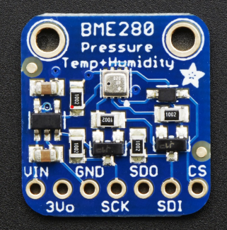
Description of the System
The BME280 sensor used here measures the relative humidity, barometric pressure and ambient temperature.
This sensor can use the i2C bus or the SPI bus. All the sensors and actuators in the factories have been configured to use the i2C bus.
The sensor data from each factory is transmitted to the other factories and to the dashboard every five seconds.
BME280 Sensor
Factory of the Future
/
07/12/2021
/

Slide 27
Description of the System
The LED and Buzzer are utilised when the factory alarm is triggered.
The function run_alarm() will trigger the alarm for a time period of sixty seconds. The LED and the Buzzer are alternatively switched on and off when the alarm is sounding.
Even if only one factory triggers the alarm, the alarm in all the factories will be triggered simultaneously.
The LED and the Relay also have separate functions to be triggered individually: set_led_state(short state) and set_relay_state(short state). If state = 0, they are off, else they are on.
Factory of the Future
/
07/12/2021
/

Slide 28
Sensors - Main Principles
Abstraction of the handling of the sensors and actuators
Enable the raspberry I2C bus
Enable the raspberry inputs and outputs
Define the architecture of the Factory
Initialization of the sensors of the factory
Initialization of the actuators of the factory
Read Data from sensors
Offer the sensor data as a service.
Receive Commands from the interfaces to drive actuators
Enable and program the Alarm (LED and Buzzer)
Check the presence of sensor and actuators
Factory of the Future
/
07-12-2021
/

Slide 29
Functions & Interfaces
Rq | Use Case | Functions | Command (handle_command())
1 | It is possible to drive the GPIO remotely. | set_led_state(); set_relay_state() | CMD_SET_RELAY_STATE
2 | It is possible to control the actuators remotely. | set_led_state(); set_relay_state() | CMD_SET_LED_STATE
5 | An alarm is sent to the system that makes the request to trigger the alarm. | trigger_factory_alarm() | CMD_TRIGGER_ALARM
6 | Each factory has at least the following information: temperature, pressure, humidity. | read_sensor_data(); store_sensor_data() | -
7 | Each factory has at least two actuators: led, relay. | has_led(); has_relay() | CMD_GET_PERIPHERALS
8 | The factories communicate with each other every 5 seconds: temperature, humidity, pressure. | broadcast_sensor_data() | CMD_SEND_SENSOR_DATA; CMD_SEND_SENSOR_HISTORY_FILE
9 | The factories have a service that communicate the list of available sensors. | has_sensors() | CMD_GET_PERIPHERALS
Factory of the Future
/
07-12-2021
/

Slide 30
Initialization
Start TCP server accept_tcp_connections_non_blocking(handle_command, &server_thread);
Initialize the sensors and data buffer
init_sensor();
init_sensor_data_buffer(&sensor_history);
Connect to the Dashboard & get factory ID
connect_to_dashboard(dashboardAddr, &host_list, &fact_ID, 1);
Check sensors & alarm state
Broadcast and store sensor data
…
Factory of the Future
/
07-12-2021
/

Slide 31
Data Structure
Transmitted to the Dashboard and each factory every 5 seconds through broadcast
Stored locally in sensor_history.dat
File with all past data is transmitted to the Dashboard or the Machine Learning Manager upon request (network)
typedef struct SensorData {
time_t time;
double temperature, humidity, pressure;
} SensorData;
Factory of the Future
/
07-12-2021
/

Slide 32
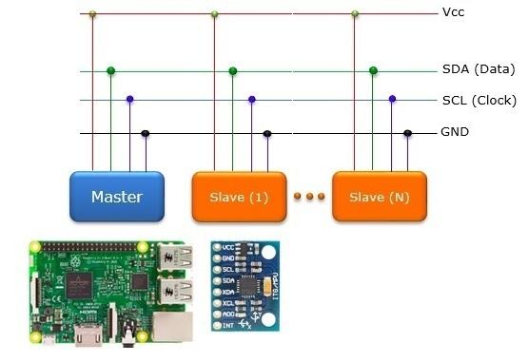
Sensors and Actuators
Enabling the raspberry I2C
Only uses two wires Serial Clock (or SCL) and Serial Data (or SDA)
- The SCL wire is the clock signal that synchronizes the data transfer between devices on the I2C bus and is generated by the master device.
- The other wire is the SDA line that carries the data.
Supports multiple masters and multiple slaves
ACK/NACK bit gives confirmation that each frame is transferred successfully

Slide 33
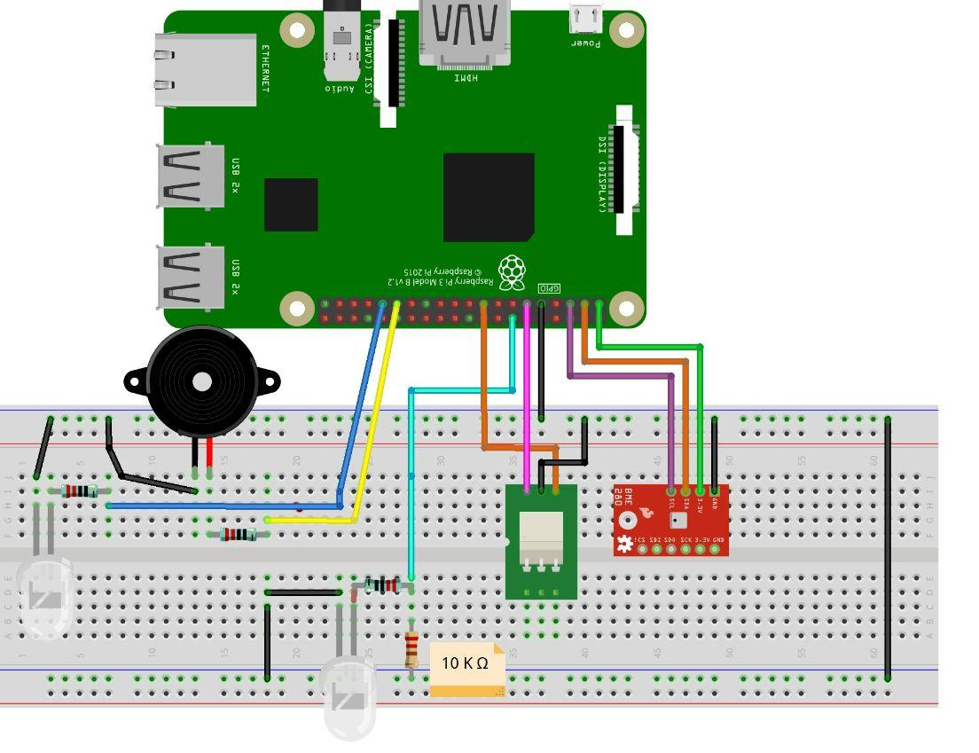
Set up
Connections diagram
-Raspberry PI3 B+
-1 breadboard
-2 LED
-wires
-3 resistors (220 Ω)
-1 resistor (10 K Ω)
-1 BME280 sensor
-1 relay
-1 buzzer
Factory of the Future
/
07-12-2021
/

Slide 34
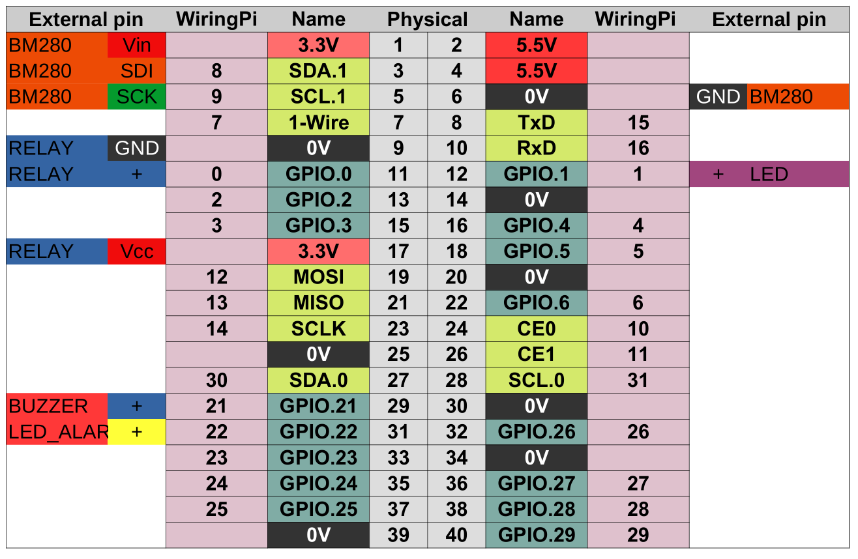
Set up
The connections are specified in the following figure
Factory of the Future
/
07-12-2021
/

Slide 35
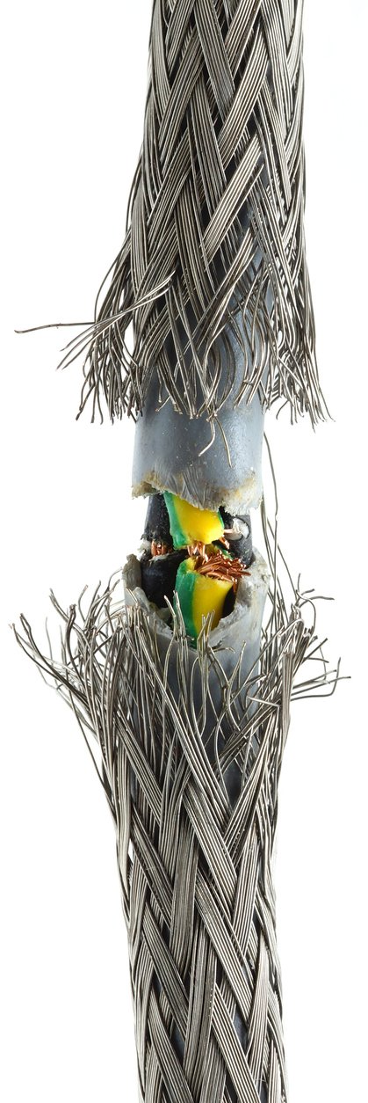
Device availability
The system requires that Factories shall be capable of giving their list of available sensors/actuators (req 6).
In order to update this list, a service is provided to check the availability of the sensors and actuators currently connected to the factory.
has_sensors()
has_led()
has_relay()
Factory of the Future
/
07-12-2021
/

Slide 36
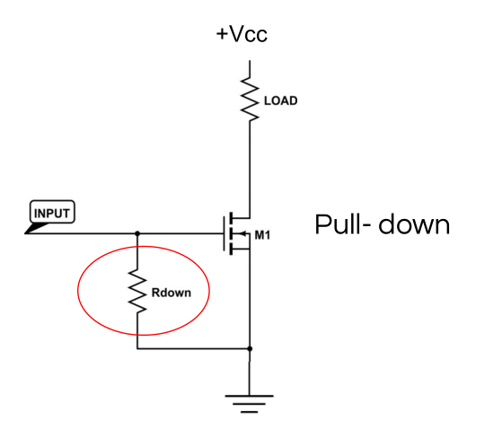
Device availability - LED
Reading a disconnected pin will return unstable values that will oscillate between 0 and 1.
An external pull-down resistor is implemented in the LED actuator, to ensure a constant value of 0 in this pin when the LED is correctly connected.
Note that depending on the nature of the failure this system may not detect the disconnection.
Factory of the Future
/
07-12-2021
/

Slide 37
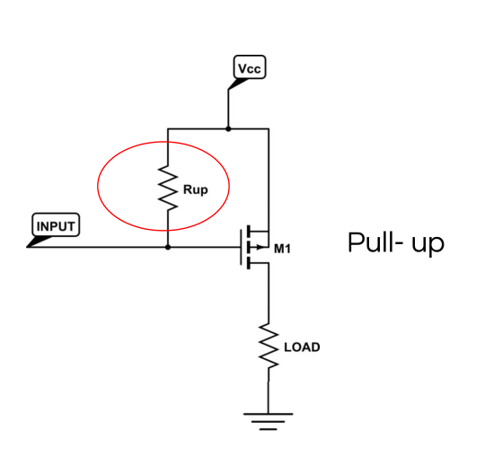
Device availability - RELAY
A similar approach is used with the relay, however in this case there is a pull up resistor in the wiring of the relay module, so the checking is adjusted to consider a logical 1 as a connected device.
Note that depending on the nature of the failure this system may not detect the disconnection.
Factory of the Future
/
07-12-2021
/

Slide 38
Device availability - BME280 sensor
For the temperature, pressure and humidity sensor, the initialization process offers a variable that indicates the status of the sensor after the initialization.
we take advantage of this to periodically check the sensor availability.
Note that the initialization process is time consuming and shall not be used every time a reading is required.
Factory of the Future
/
07-12-2021
/

Slide 39
Machine Learning
Bárbara, Jerzy, Kaavya & Maanasa

Slide 40

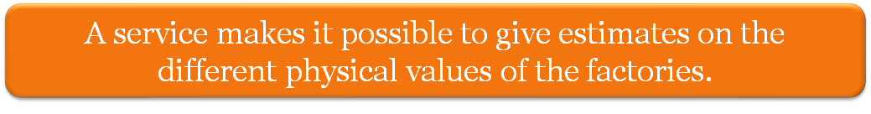
Machine Learning - Main Principles
Requirement:
To define in advance the behaviour of the system;
To use linear regression on the evolution of temperature sensor;
To give estimates on the different physical values of factories.
Factory of the Future
/
07-12-2021
/
Notes:
Jerzy

Slide 41
Machine Learning - Procedure
Data Collection;
Data Preparation;
Choose a model;
Train the model;
Apply the model/Make predictions.
Factory of the Future
/
07-12-2021
/
Notes:
Jerzy

Slide 42
Machine Learning - Data Collection
Time and the corresponding temperature;
Data Set - 18 days, collecting every 10 minutes;
1974 values for training (80% of the data);
494 values for prediction (20% of the data);
Factory of the Future
07-12-2021
Notes:
Jerzy

Slide 43
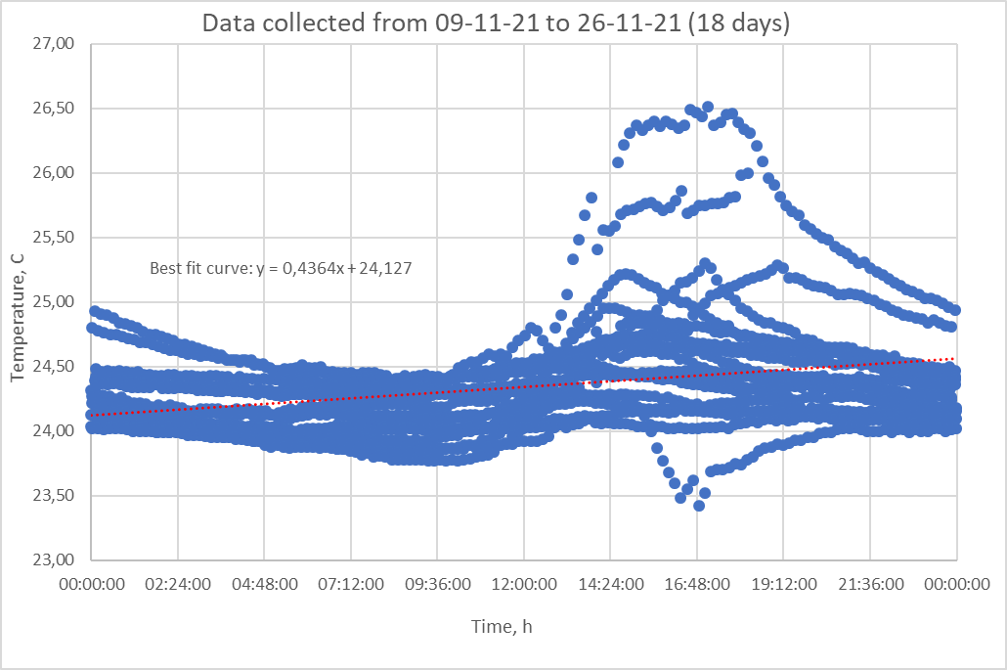
Machine Learning - Data Preparation
Linear (1st degree) best fit curve
Factory of the Future
/
07-12-2021
/
Notes:
Jerzy

Slide 44

Machine Learning - Data Preparation
2nd degree polynomial best fit curve
Factory of the Future
/
07-12-2021
/
Notes:
Jerzy

Slide 45

Machine Learning - Data Preparation
3rd degree polynomial best fit curve
Factory of the Future
/
07-12-2021
/
Notes:
Jerzy

Slide 46
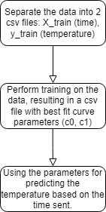
Machine Learning - Model flow chart
Input data
Training
Prediction
Factory of the Future
/
07-12-2021
/

Slide 47
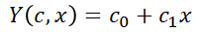
Machine Learning - Choose a model
From GSL - GNU Scientific Library:
Linear regression with a constant term
get_matrix_dims gsl_matrix_alloc load_matrix_from_csv gsl_matrix_transpose_memcpy gsl_blas_dgemm gsl_permutation_alloc gsl_linalg_LU_decomp gsl_linalg_LU_invert gsl_matrix_sub gsl_matrix_get gsl_matrix_scale
Factory of the Future
`
/
07-12-2021
/
Notes:
Barbara - Explain what linear regression is

Slide 48
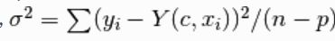
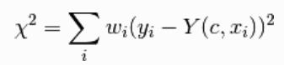
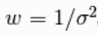
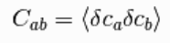
Machine Learning - Choose a model
From GSL - GNU Scientific Library:
Linear regression with a constant term
Weights
Covariance Matrix
Factory of the Future
`
/
07-12-2021
/
Notes:
Barbara - Explain what linear regression is

Slide 49
Sequence Diagram - Real time prediction
Machine Learning
Dashboard
Factory 3
Predict (3,time)
download_history_file
(download file)
(Fit)
(Temperature)
23,49
Factory of the Future
/
07-12-2021
/
Notes:
Maanasa

Slide 50
Machine Learning - Real time prediction
predict 3 10 20 30 (predict factID hour minute second) -> Accepts predict command from dashboard (Network)
function receives_sensor_history_file -> Request and receive history file from factory
function append_factory_data -> Append data to existing factory sensor data
function fit -> Train the linear model
function predict_temp -> Predicts the value of temperature for a given factory at the requested time
Factory of the Future
/
07-12-2021
/
Notes:
Maanasa

Slide 51
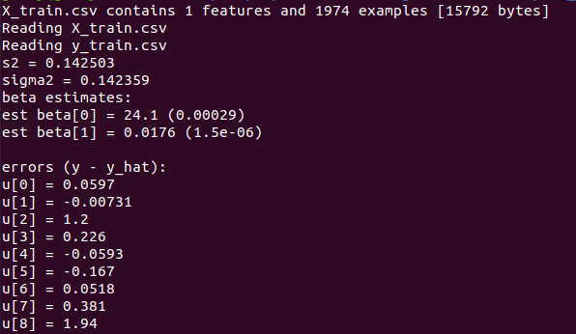
Machine Learning - Training and evaluation
Using the features available on GSL - GNU Scientific Library, the model was trained to predict the temperatures in 24h range using 80% of collected data.
Factory of the Future
/
07-12-2021
/

Slide 52
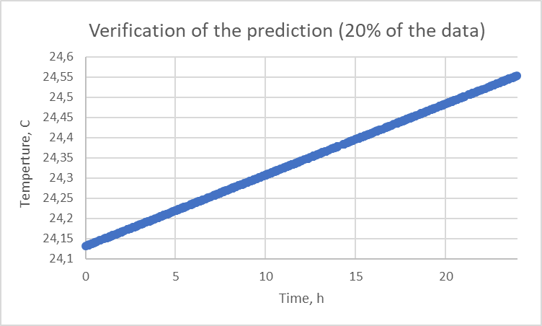
Machine Learning - Prediction verification
Factory of the Future
/
07-12-2021
/

Slide 53
Demo
Entire Team

Slide 54
DEMO - Connecting all hosts
Instance | Lab ID | IP Address
Dashboard | 16 | 192.168.47.60
Factory 1 | 8 | 192.168.47.44
Factory 2 | 10 | 192.168.47.48
Factory 3 | 11 | 192.168.47.50
Factory 4 | 14 | 192.168.47.56
ML Module | 15 | 192.168.47.58
./dashboard
./factory [dashboard IP]
./ml [dashboard IP]
Factory of the Future
/
07-12-2021
/
Notes:
Maanasa

